Slide 1
RETROtransposon
for everything retrotransposon-y
Maroua Akkari
Esteban Gómez Cifuentes
Vithusaa Selvachandrarajah

Slide 2
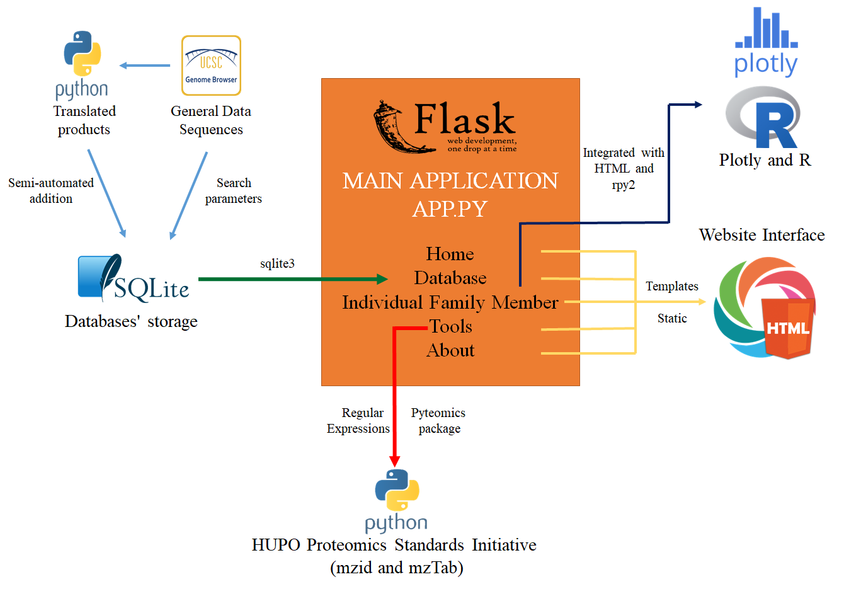
Software Architecture
Notes:
Retrotransposon is built using the framework from python called Flask. To make everything works the main application has to call different tools and functions from several programming languages. So for example it calls HTML templates for the Website Interface, the graphs were creating using plotly and R, the database was created using the SQLite environment and the mass spectrometry reading tool uses a python package calls pyteomics. Everything is connected with Flask.

Slide 3

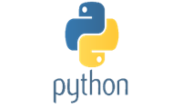
Data Collection
genoName
genoStart
genoEnd
strand
repName
repClass
repFamily
repStart
repEnd
CSV files
FASTA files
DNA Sequences
Table Browser*
*For LINE-1: “L1” in repFamily
For HERV: “LTR” in repClass
ORF Identifications
Notes:
Currently, RETROtransposon contains information about the families LINE-1 and HERV. The information was obtain using Table Browser from UCSC Genome Browser. We got two kind of files: CSV files with general information for each retro and FASTA files that contains the DNA sequences, than later we used for ORF identification and the translated products identifications.

Slide 4
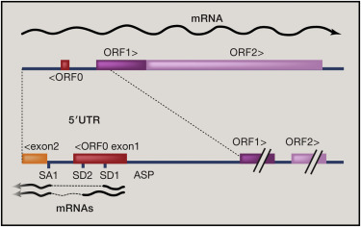
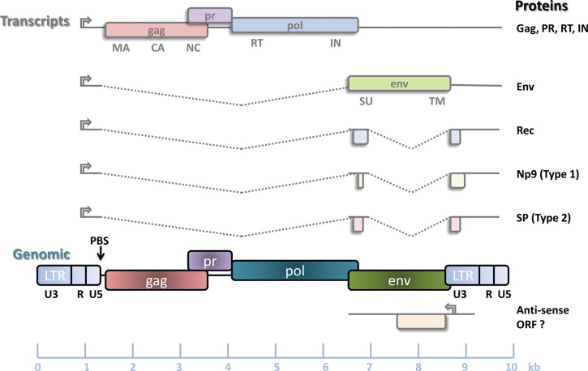
ORF Identifications
ORF1 (500 aa)
ORF2 (RT, Endo)
ORF0 (300 aa)
Gag (MA, CA, NC)
Pol (RT, RNase H, Int)
Env (500 aa)
Conserved C-terminal domain
Endonuclease functional domain.
Alignment in Denli A, et al., 2015
Zinc Finger CCHC type domain
Motifs from the RT and RNase H
Motifs from disulfide bond
Boeke & Fenyo, 2015.
Douville & Nath, 2014.
Notes:
For ORF Identifications we designed a program that finds intact ORF (meaning it has a start and end codon). We know that LINE-1 has three ORFs: ORF1, of 500 aa, that codes for a RNA binding protein, ORF2, a polyprotein that has a RT and an Endonuclease (1200aa) and a ORF0 (in the opposite direction). For the identification we got motifs from…
Since HERV retrotransposon are endogenous retroviruse, they have the same configuration than a regular retrovirus: three polyproteins..

Slide 5
Motifs
ORF1:
RREWGPIFN[IT]L
ORF2:
CWRGCG and LKI[KT]GWRK[IS]YQ[AV]N
ORF0:
M[AV][GD][ATY]
Gag:
CX2CX4HX4C
Pol:
LPQG, YXDD and [GE]X3D
Env:
CX6C[CHRYS], CX7[CY][CS] and CX6F

Slide 6
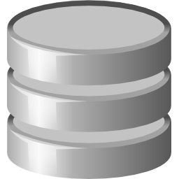

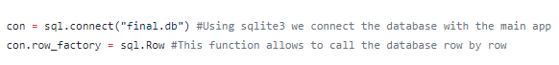
Database Management
CSV files:
General Information and Translated Products
DB Browser for SQLite
sqlite3

Slide 7
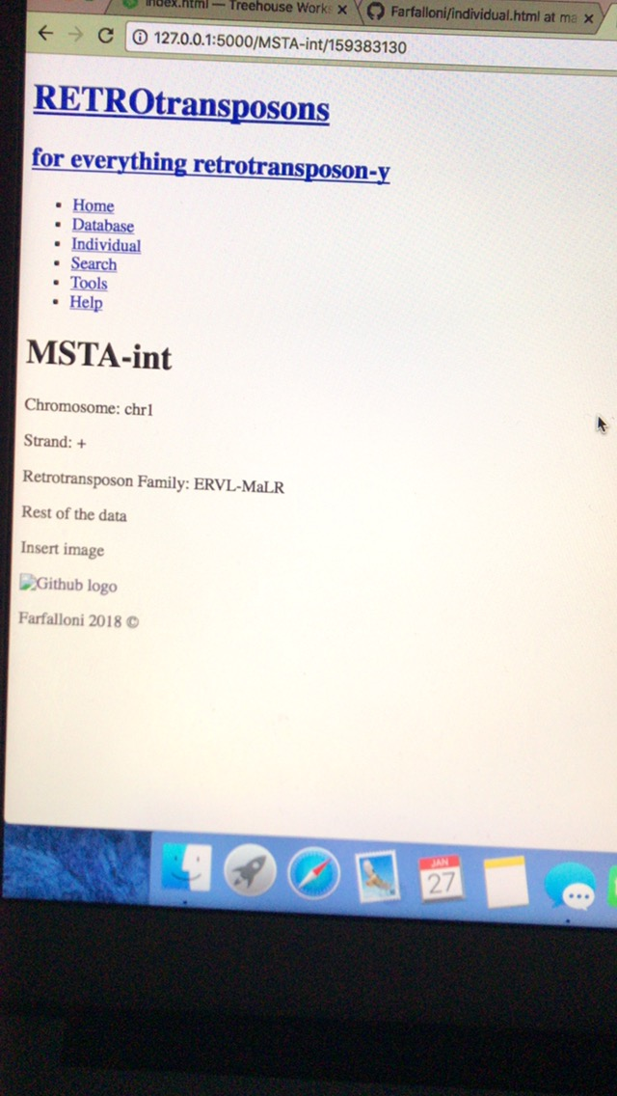
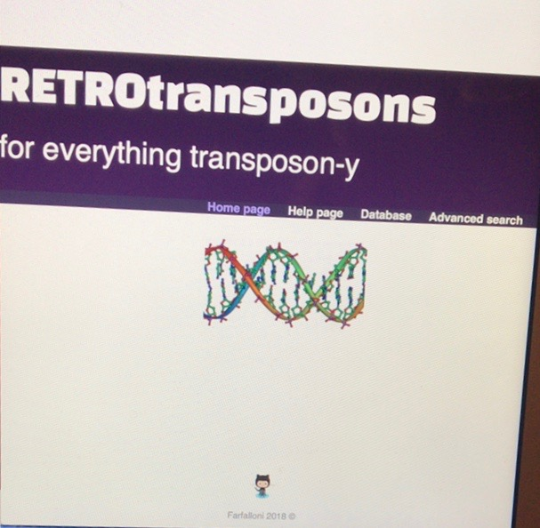
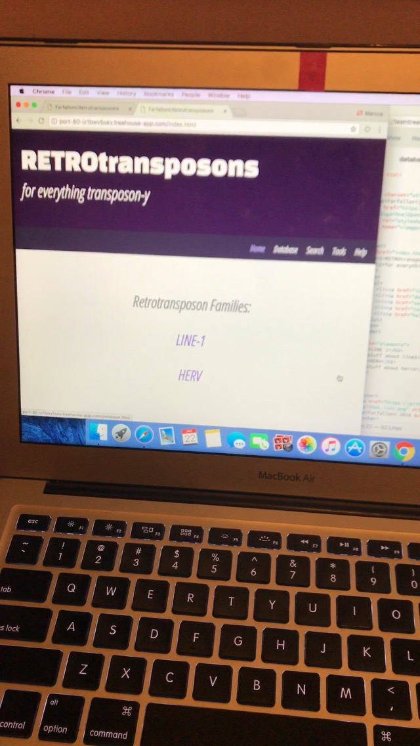
Interface Design

Slide 8
Connecting HTML and CSS
<head> all style sheets and external jquery </head>
<style> specific css </style>
<script> .hover/hide/show </script>
<body> navigation bar graphs texts tables </body>
<footer> octocat github link </footer>

Slide 9
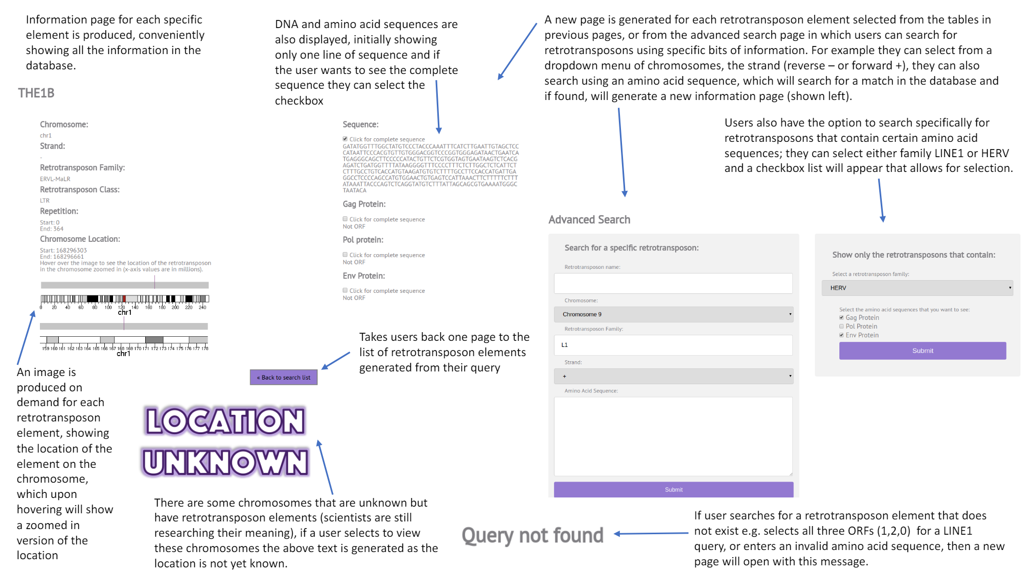
Calling database in HTML files
Individual page
html file calls the app.py file which calls the database. the html page calls the information in the column for the particular row in the database --- strand
<h4>Strand:</h4>
<p>{{ind["strand"]}} </p>
Search page - using method=get
<form action="{{url_for('results')}}" method='get'>
<label class="pep-seq">Retrotransposon name:</label>
<input type="text" name="repName">

Slide 10

Problems
drop down menu
interactive table
CSS file
margins/padding

Slide 11

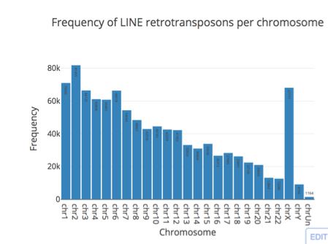
Plotly
Interactive bar charts generated
Plotly python libraries and pandas module
Bar chart to show frequency of LINE/ERV retrotransposons on each chromosome
All charts can be saved, zoom, and many more features

Slide 12
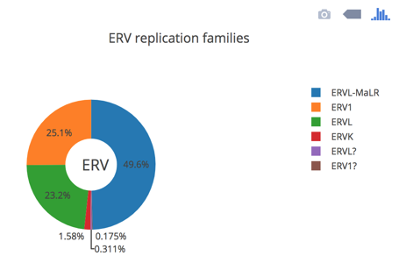
Interactive donut chart created using Plotly's python libraries and pandas module
Chart shows % frequency of each ERV repNames
Donut chart to represent % of LINE ORF’s (ORF0, ORF1 and ORF2)

Slide 13

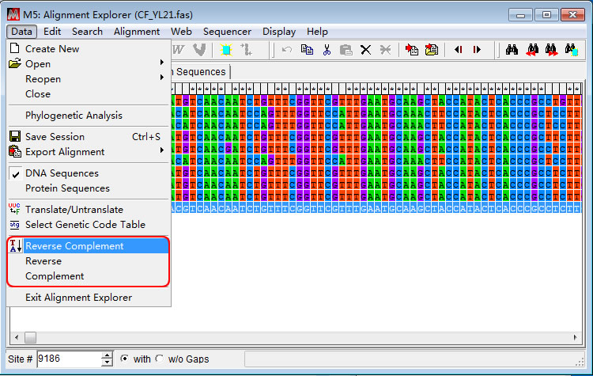
Phylogenetic tree
Trees created using MEGA7 software
Multiple sequence alignment with clustalW for ORF sequences
Parameters:
a gap opening penalty 10,
gap extension penalty of 0.2,
Protein weight matrix: Gonnet
divergent cut-off at 30%
Distance computed using pairwise
Dayhoff matrix
Bootstrap 100
Neighbour-joining method to produce estimate tree

Slide 14

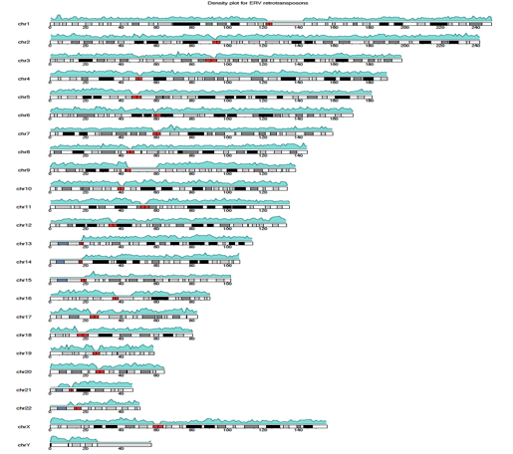
Karyotype
- Karyotypes generated in R using an R package called karyoploteR
- Plots genomic features along the genome (‘hg38’)
- Density plot showing the distribution of the chromosome coordinates (start and end) for LINE and ERV retrotransposons
- kpPlotDensity function computes and plots the densities of the features along the genome.

Slide 15
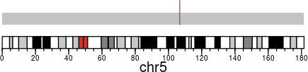
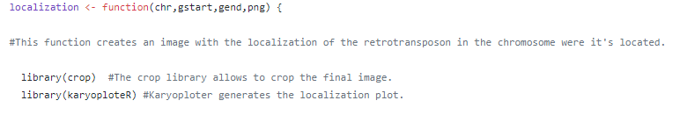

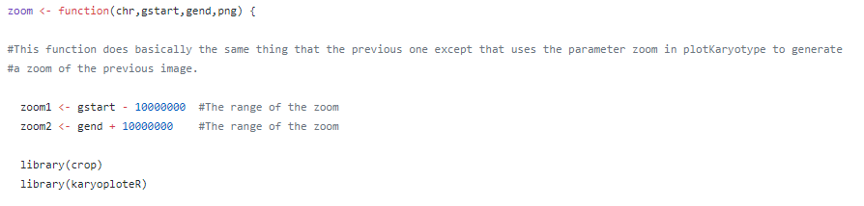
cariofunctions.R

Slide 16


MSRetroFinder
Small tool that allows to upload mzIdentML or mzTab files and performance a comparison of all the peptide identifications in those files against the RETROtransposon database and search if there is any match.
mzIdentML and MzTab files
Peptide Identifications
Query not found
MSRetroFinder
ATLAS

Slide 17
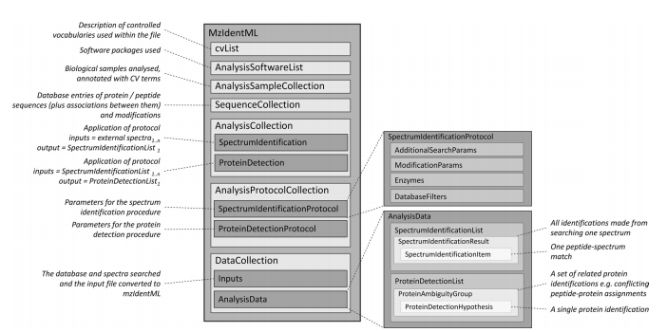
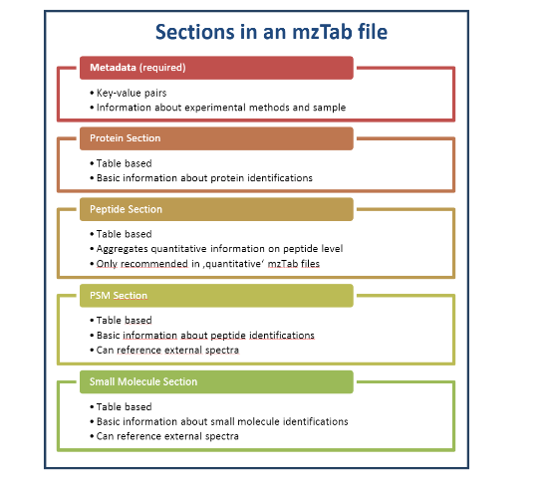
mzIdentML and mzTab
mzIdentML
mzTab
Jones, et al., 2012.
Griss & Vizcaino, 2014.
Pyteomics
Regular Expressions

Slide 18
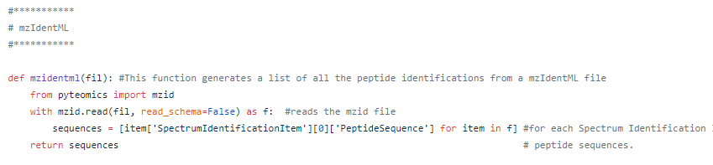
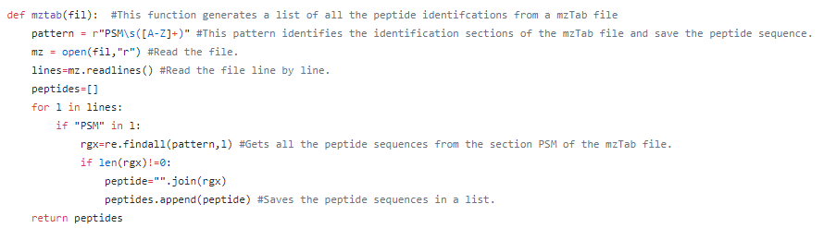
massapp.py

Slide 19
Requirement and Installations
The following software packages are required to be downloaded and were run in the following
order:
- PYTHON 2.7.14
- R 3.4.1
- FLASK (python framework)
- RPY2 2.7.0 (python package)
- PYTEOMICS (python package)
- BIOCLITE, KARYOPLOTER, CROP (R libraries)

Slide 20
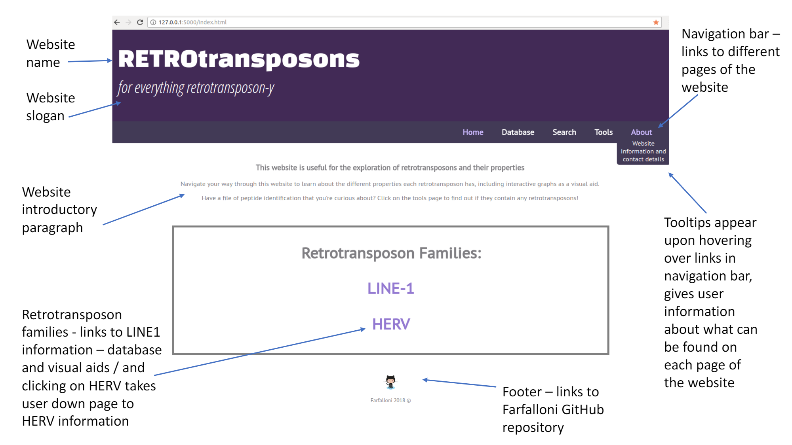
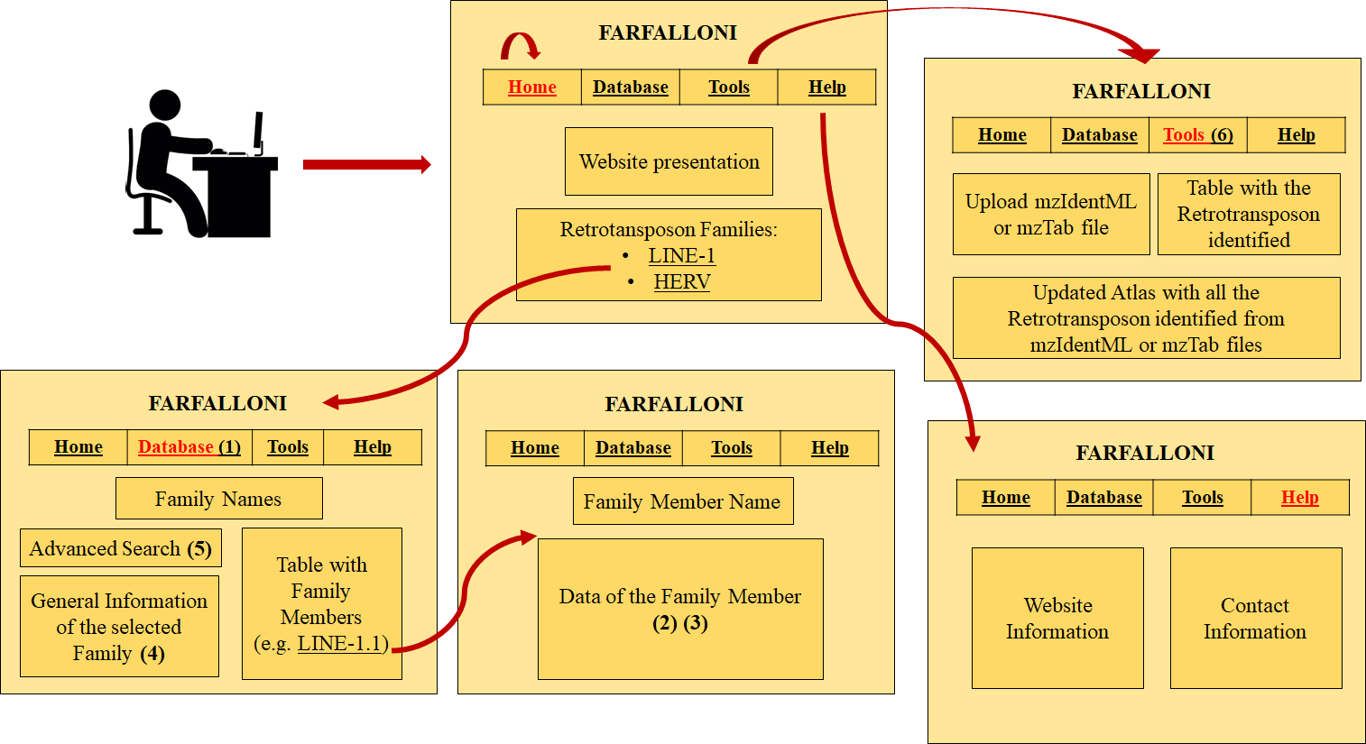
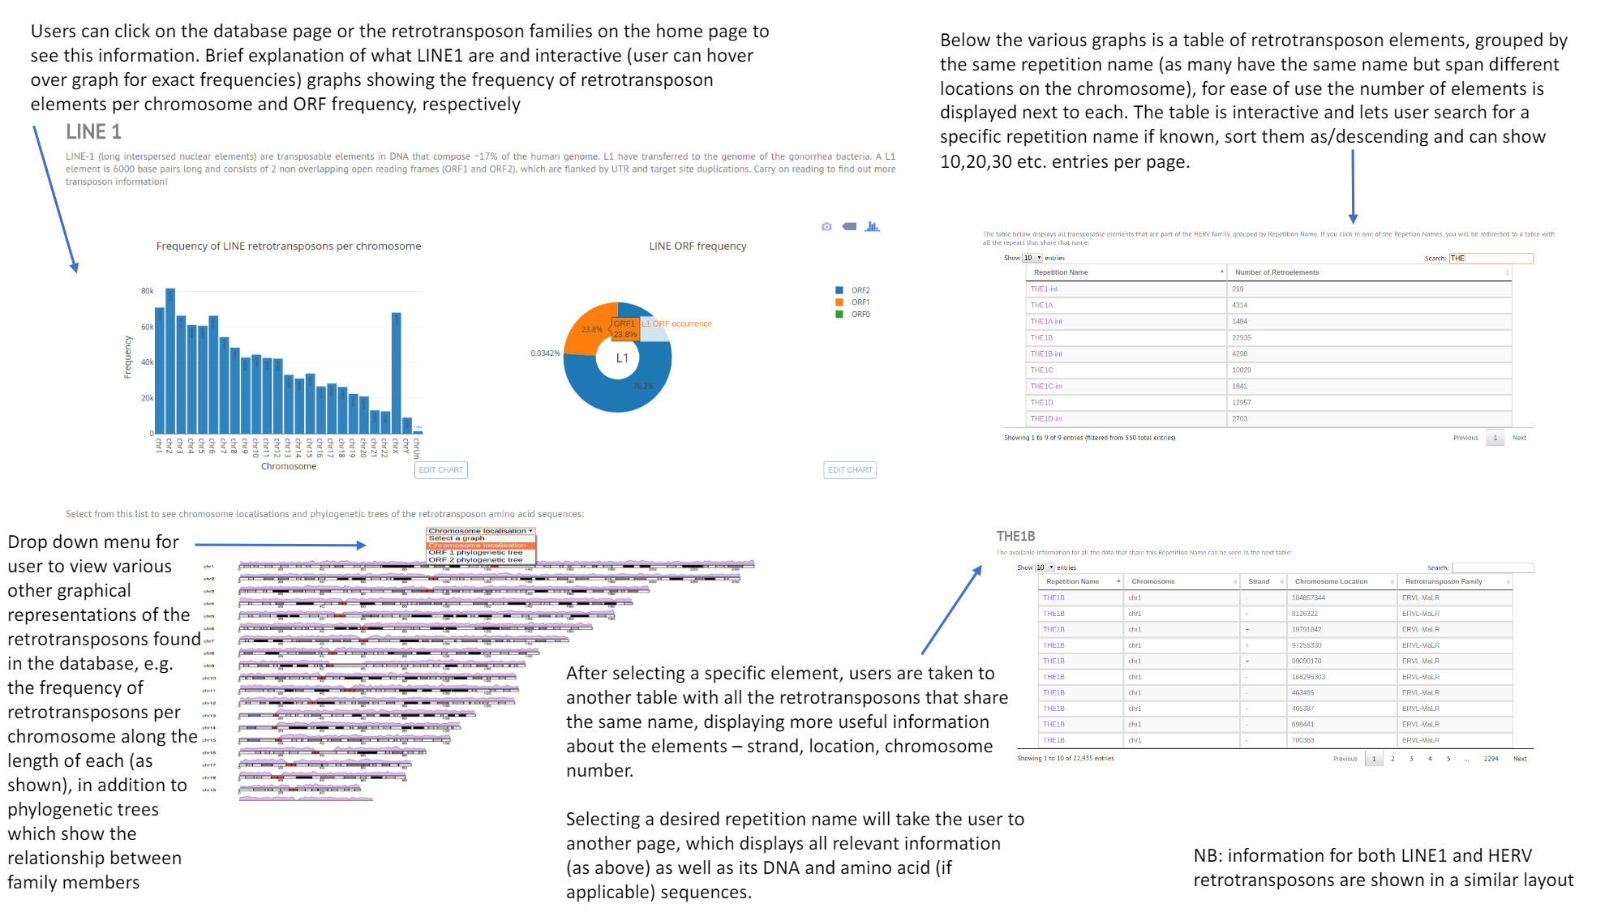
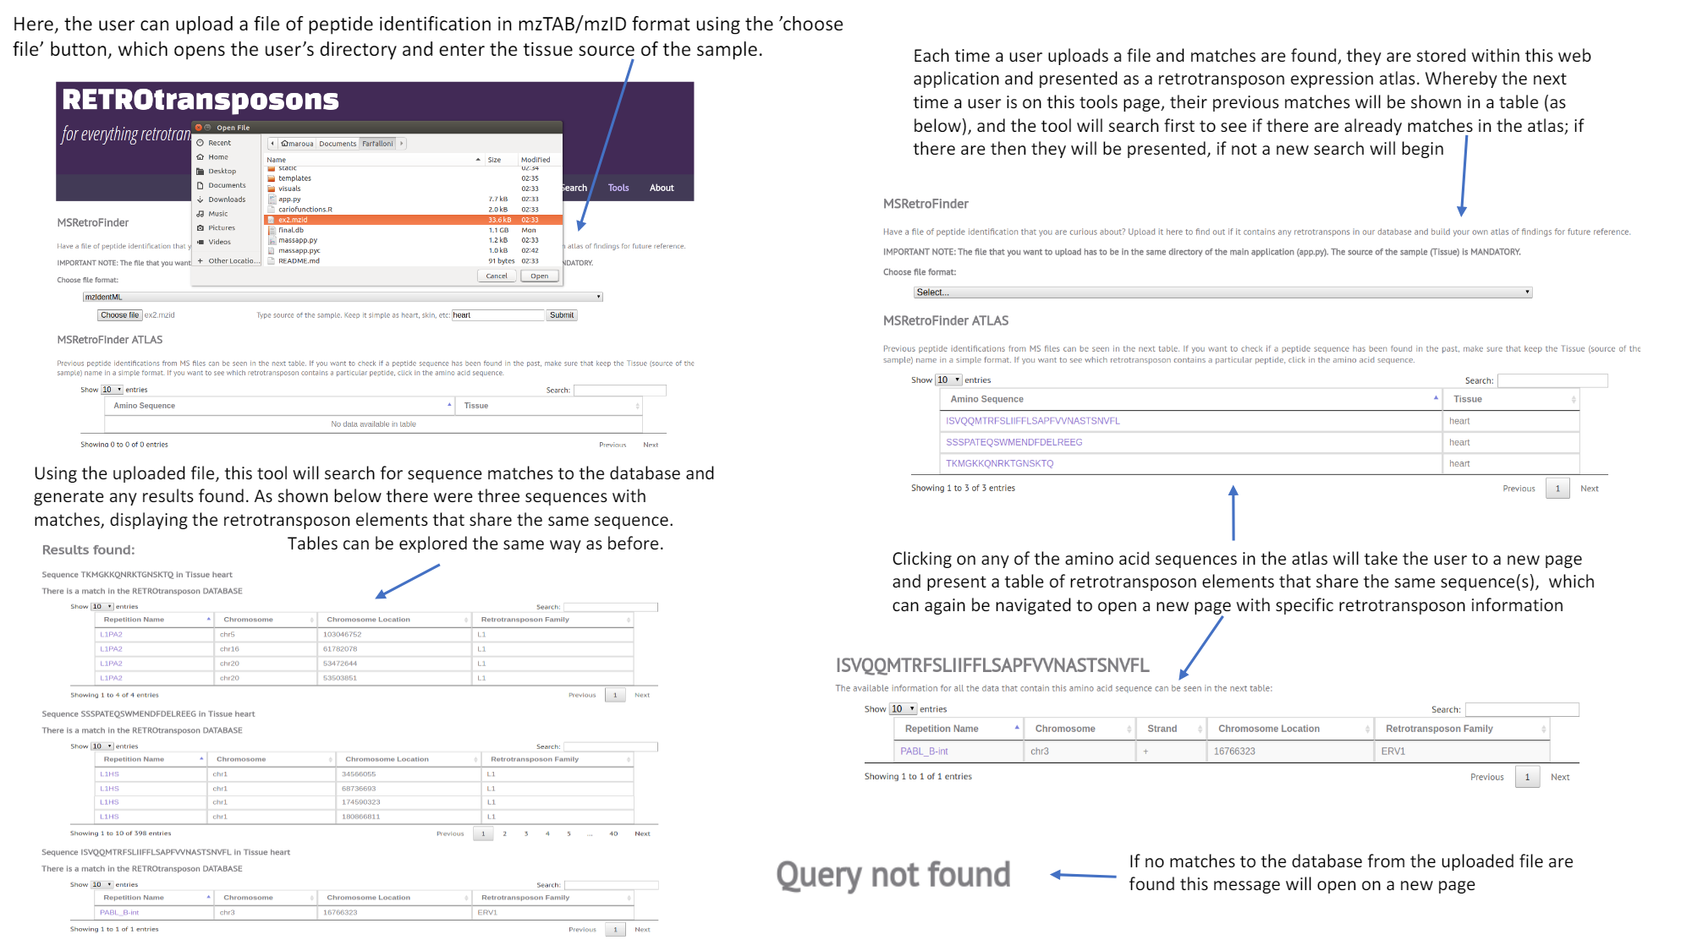
Before and After

Slide 21
Perspectives
Security - encrypt database
Speed - WSGI HTTP server that runs the flask - app can handle more requests per second → faster!
New data
Download the data as CSV and FASTA files
mzIdentML and mzTab files location

Slide 22
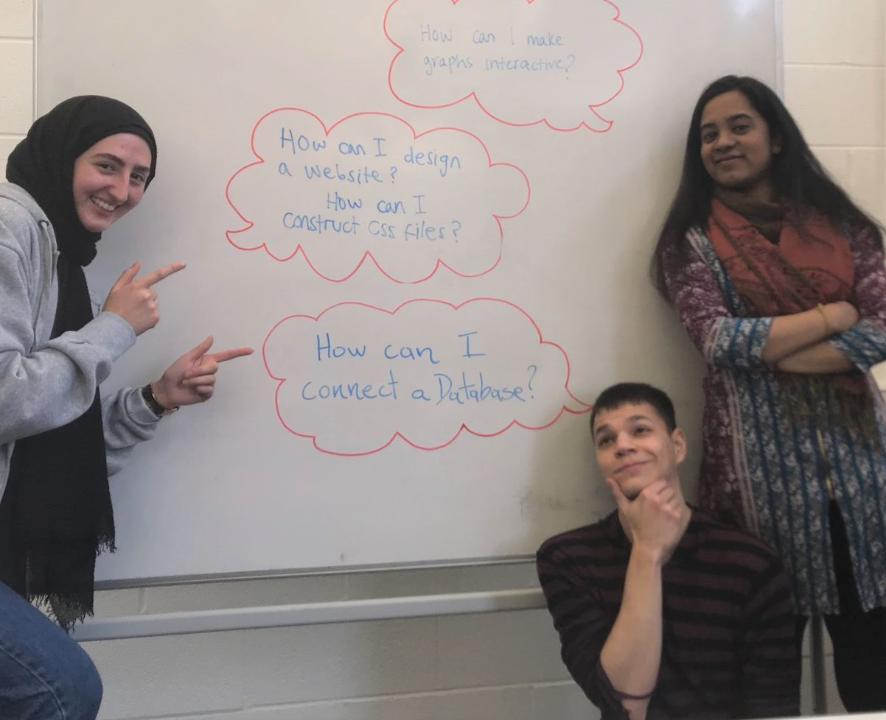
Thank you!!!

